Slide 1
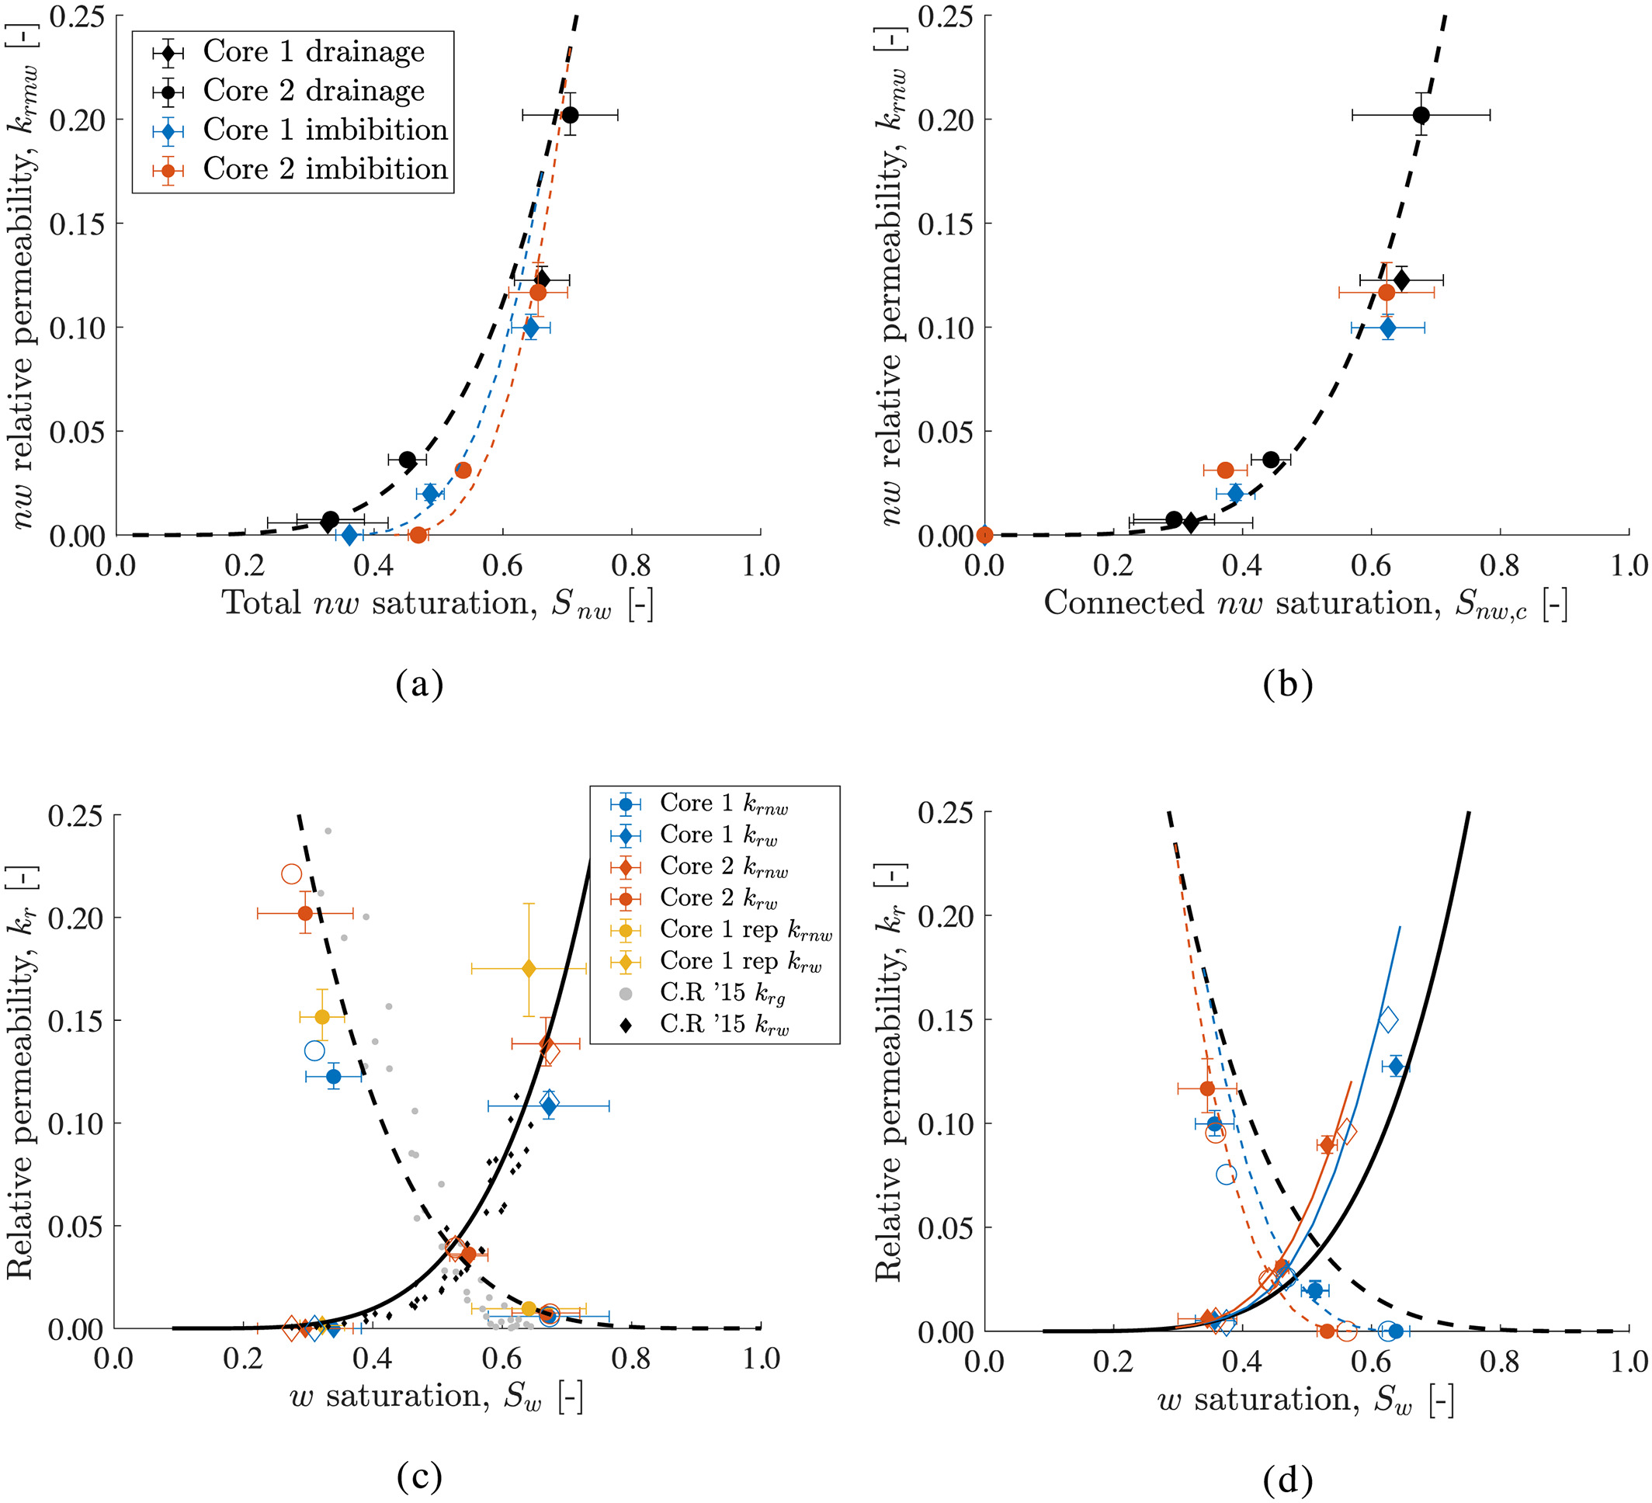
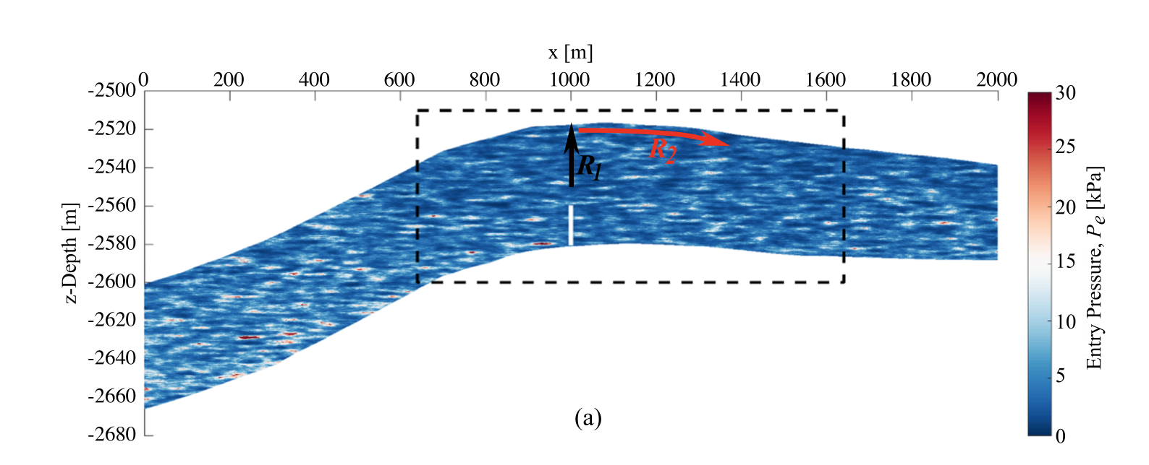
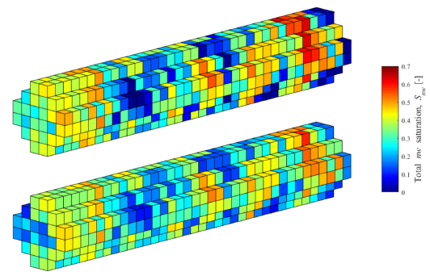
Software demonstration
Field scale characterization
Speaker: Senyou An
Investigator: Samuel Krevor (PI), Nele Wenck, Samuel Jackson

Slide 2
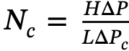
Research background
The viscous or buoyant terms dominate at spatial scales of order 1 m and greater. Capillary pressure gradients can be ignored over field scales because they contribute little to fluid movement.
The establishment of equilibrium in capillary pressure over small length scales in heterogeneous rocks has a significant impact on the local fluid mobility.
Dimensionless capillary number
Challenge: Most of approaches overlook a key impact that small-scale heterogeneity in capillary pressure characteristics can have on large-scale plume migration.

Slide 3
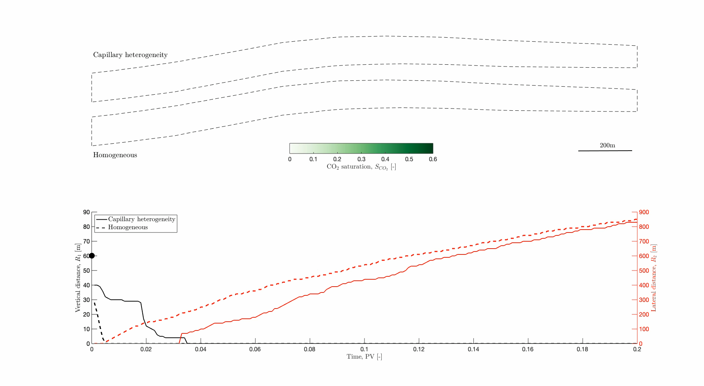
Research background

Slide 4
Milestones
Summary of Milestones and Deliverables
Ref | Title | Responsibility | Due Date (Mo)
M1.1 | Codes for reservoir characterisation are created and tested | ICL | 6
M1.2 | Codes for flow function generation are created and tested | ICL | 12
D1.1 | Open source research codes for the characterisation of multiphase flow heterogeneity and conversion to flow functions for reservoir simulation | ICL | 18
D1.2 | A report detailing the workflows for reservoir characterisation, and model creation and use | ICL | 18

Slide 5
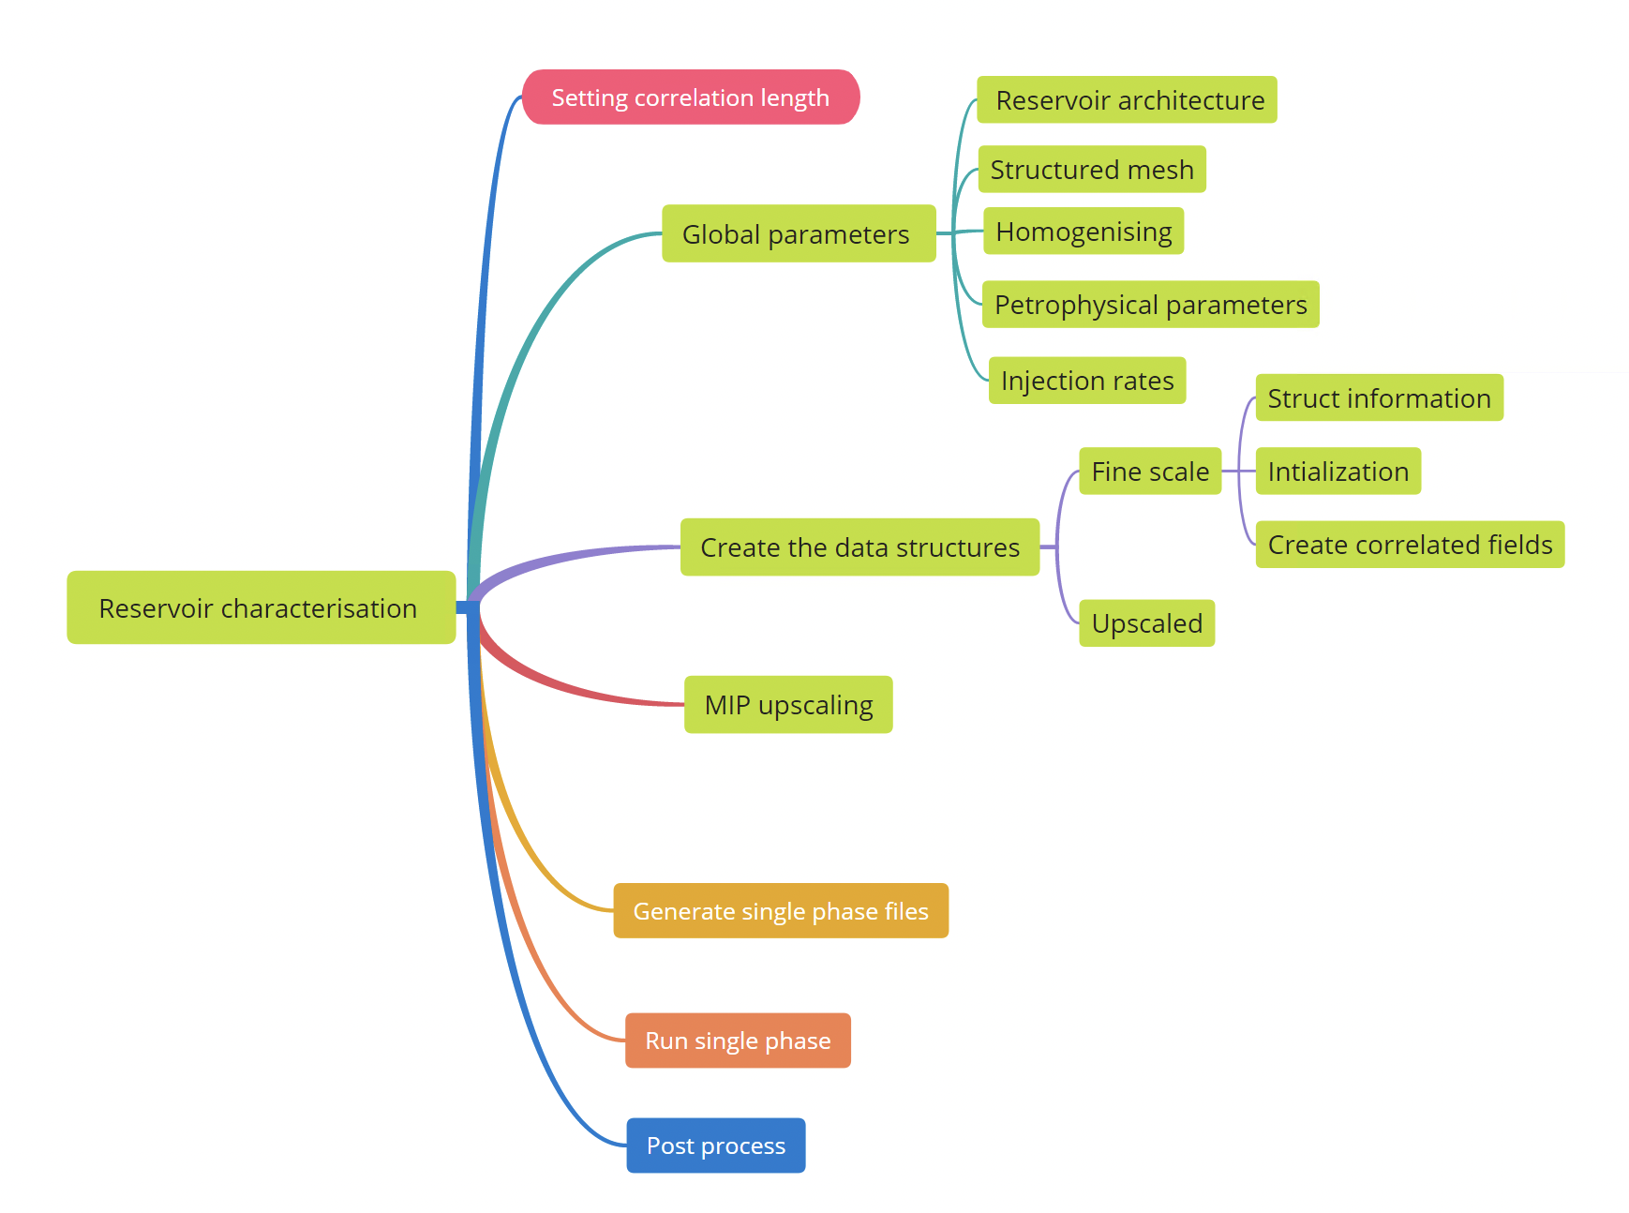
Flowchart

Slide 6
Flowchart
0, 10, 2
80, 200, 200
20, 50, 50
Perm, mu, rho, phi, pc, etc.
Coarsen based on the scales

Slide 7
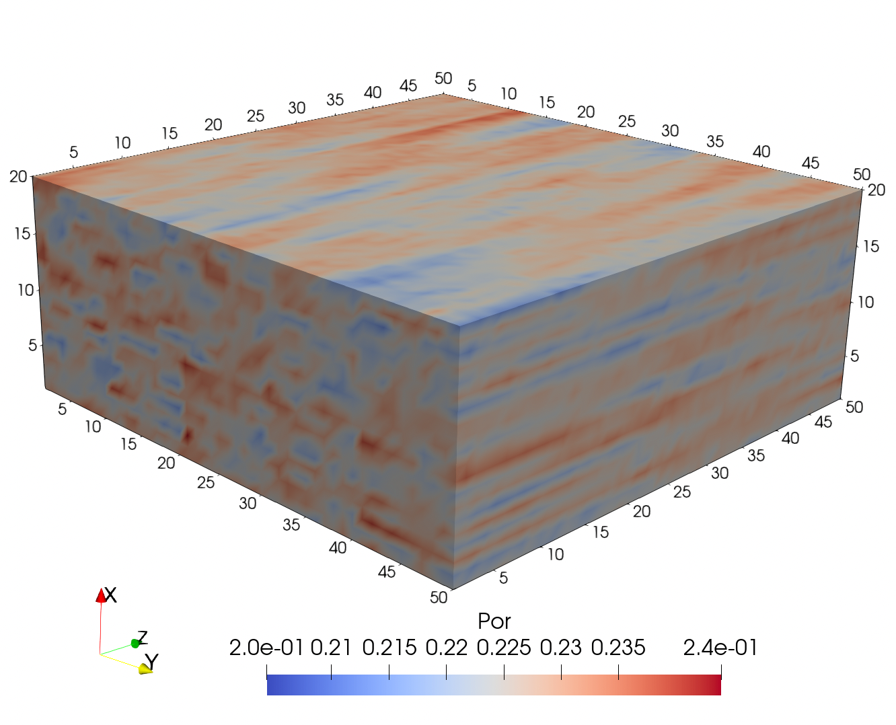
Correlated porosity

Slide 8
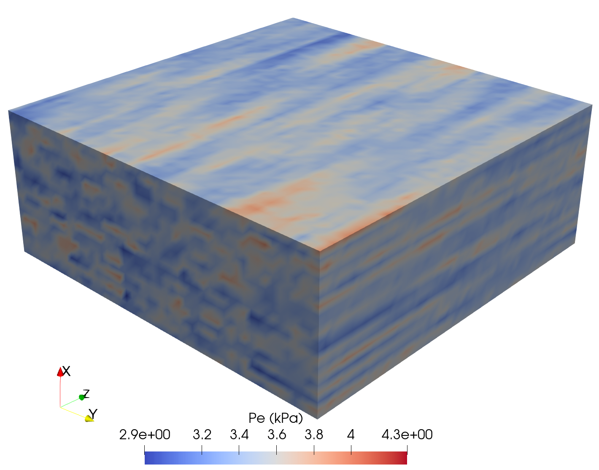
Correlated Pe

Slide 9
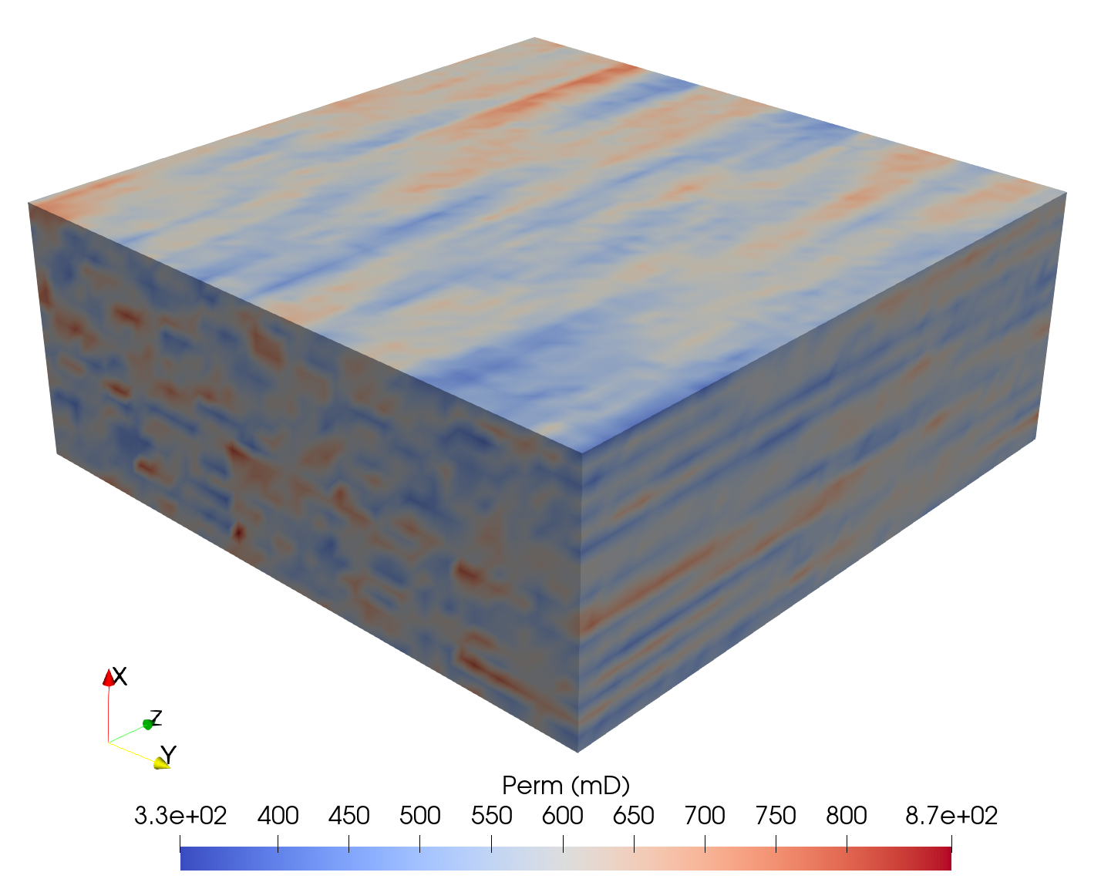
Correlated permeability

Slide 10
Software demonstration
Field scale characterization
Thanks for you listening!
Look forward to discussing with you!
Further information?
Sam Krevor: s.krevor@imperial.ac.uk
Senyou An: s.an@imperial.ac.uk
21/09/2022

